Slide 1
Web App With Rapid API and Deployment in Cloud
Blesson John Abraham:245045
Haritha T H : 245205

Slide 2
What is rapid api?
It is a marketplaces for API’s
Provided by Microsoft and it cracks 10k API’s
Rapid Api is a marketplace where we can find and connect to API as a consumer.

Slide 3

Different Steps
Create a Spring boot App
Use Rapid API s from https://rapidapi.com/
Create the JAR file
Create the corresponding frontend using angular
Using ng build command create dist files
Connect spring boot and angular
In AWS ElasticBeanStack deploy the backend using JAR file
Replace the localhost URL in angular’ s service file with EBS enviornment link
Create an S3 bucket for front end deployment
Upload files in dist folder and deploy
Use the generated link to access the web page

Slide 4
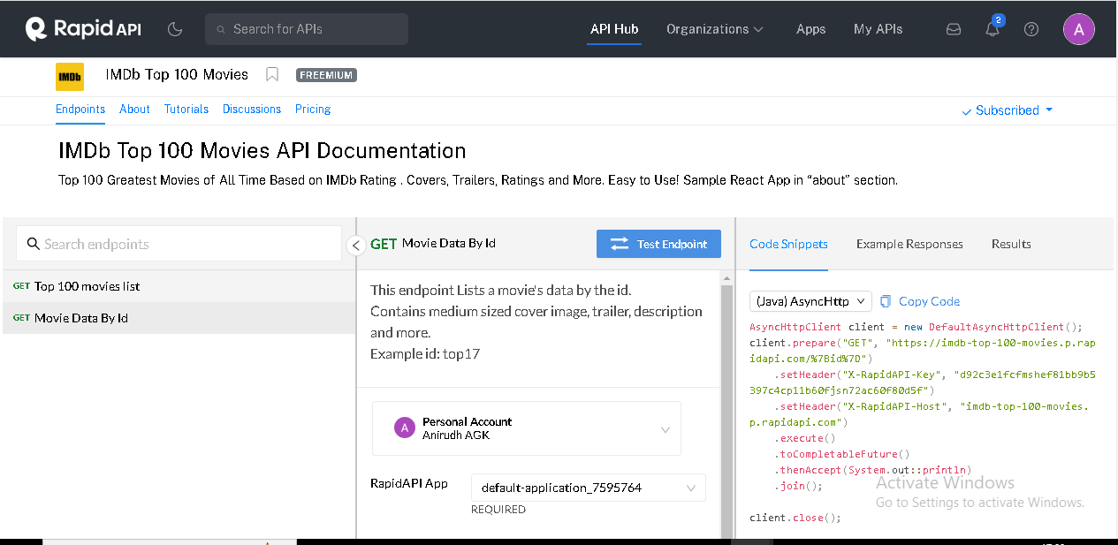
example
Top 100 movies list

Slide 5
reference
https://github.com/BLESSON-UST/Rapid_Movies_Complete_EBS

Slide 6
Thank you

